Slide 1
Stock Market Analysis -Reliance Stock Forecasting

Slide 2
Team 1
Mentors: Rajashekhar
Pallavi
Teammate Names:
-Srinu Guddala
-Prajnya Kulkarni
-Uzra Furqan
-Neehan Viren Aiya
-Vinay Elagala

Slide 3
Business Problem:
Objective:
Predict the Reliance Industries Stock Price for the next 30 days.
There are Open, High, Low and Close prices that you need to obtain from the web for each day starting from 2015 to 2022 for Reliance Industries stock.
Split the last year into a test set- to build a model to predict stock price.
Find short term, & long term trends.
Understand how it is impacted from external factors or any big external events.
Forecast for next 30 days.

Slide 4
Project Flow
Data Scrapping
Data pre processing
EDA
Data splitting
Model Building

Slide 5
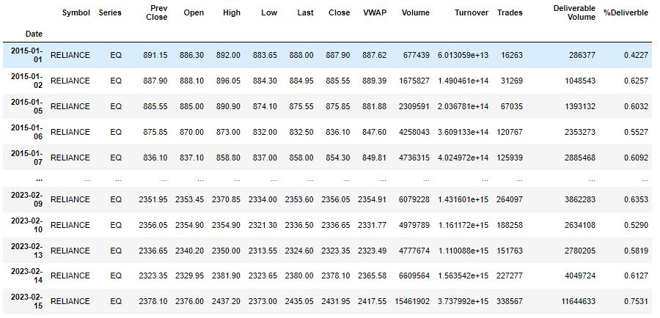
Data Scrapping
Data scrapping was done by nsepy library.

Slide 6
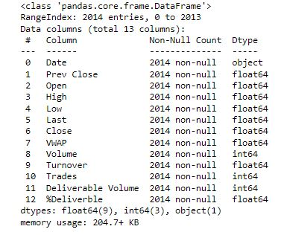
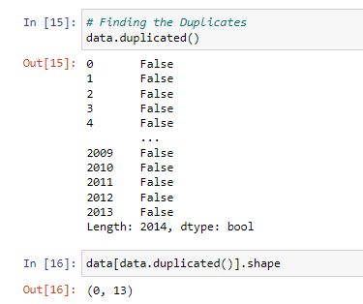
Details of the dataset
there are 2014 rows of data available and for each row, we have 13 different features or columns.
there are no null values in the data set.
There are no duplicates values.

Slide 7
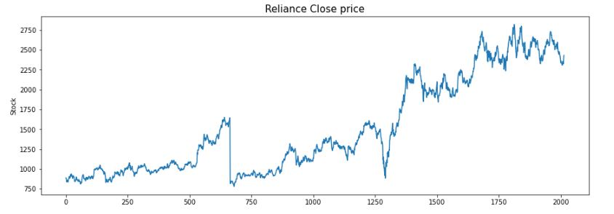
Exploratory Data Analysis (EDA)
The prices of Reliance stocks are showing an upward trend as depicted by the plot of the closing price of the stocks.

Slide 8
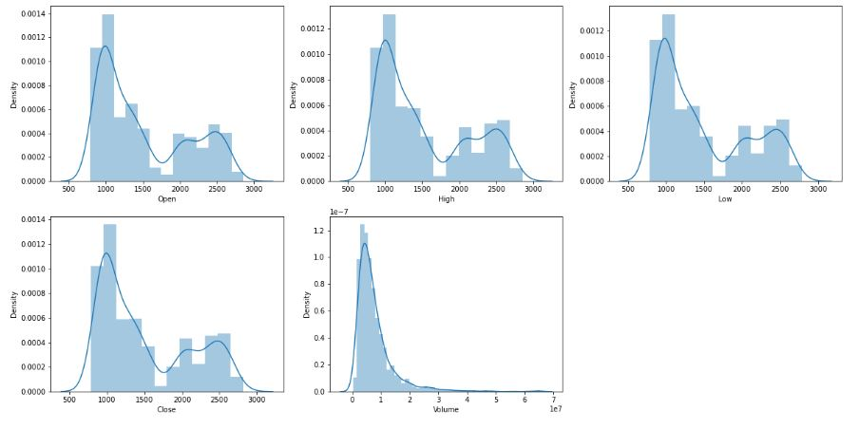
Continue…
There are two peaks which means the data has varied significantly in two regions, and the Volume data is left-skewed.

Slide 9
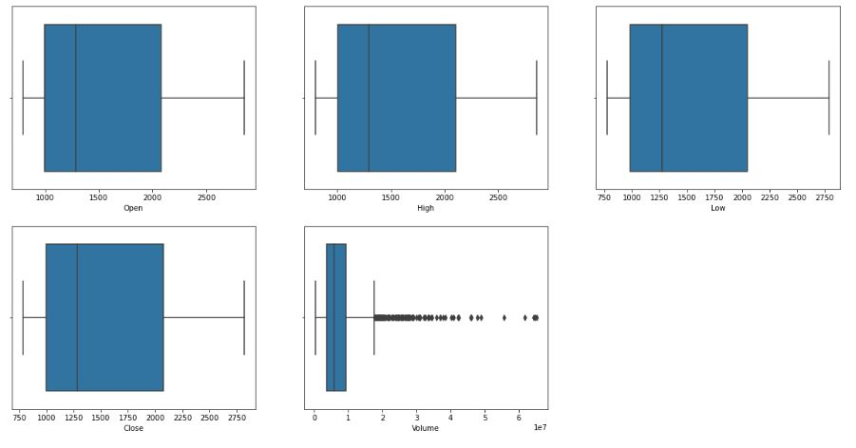
Continue…
From the given boxplot, we can conclude that only volume data contains outliers in it but the data in the rest of the columns are free from any outlier.

Slide 10
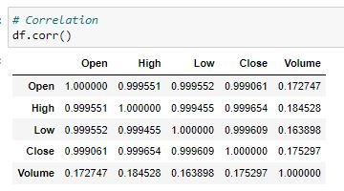
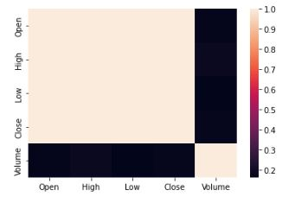
Continue
From this we can say that Open
Price, Close price, highest point of
the stock price and lowest point of
the stock price are highly
correlative.

Slide 11
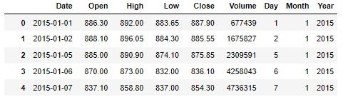
Feature Engineering
Feature Engineering helps to derive some valuable features from the existing ones.
These extra features sometimes help in increasing the performance of the model significantly and certainly help to gain deeper insights into the data.
Now we have three more columns namely ‘day’, ‘month’ and ‘year’ all these three have been derived from the ‘Date’ column which was initially provided in the data.

Slide 12
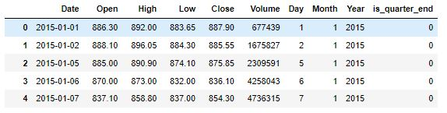
Continue…
A quarter is defined as a group of three months. Every company prepares its quarterly results and publishes them publicly so, that people can analyze the company’s performance.
These quarterly results affect the stock prices heavily which is why we have added this feature because this can be a helpful feature for the learning model.

Slide 13
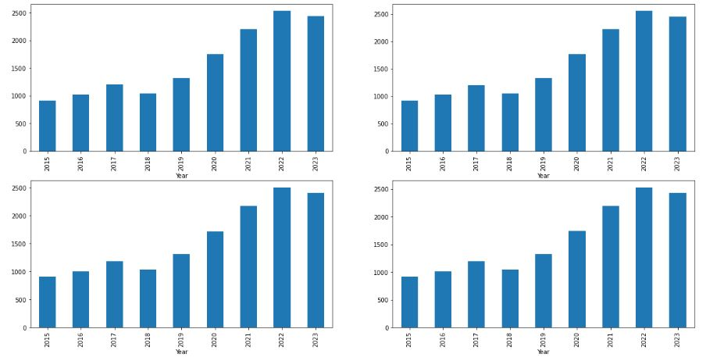
Continue…
From the above bar graph, we can conclude that the stock prices have doubled from the year 2018 to that in 2021.

Slide 14
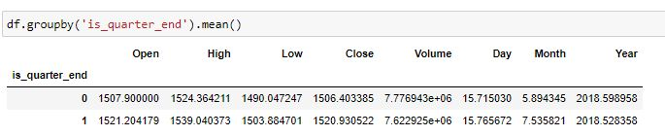
From this we can say that Prices are higher in the months which are quarter end as compared to that of the non-quarter end months.

Slide 15
Data Splitting and Normalization
For data splitting X is holding values for the open, high and low column and Y is holding values of the close price column.
Whole data has been split into two parts with last year taken as test data, that we can evaluate the performance of our model on unseen data.

Slide 16
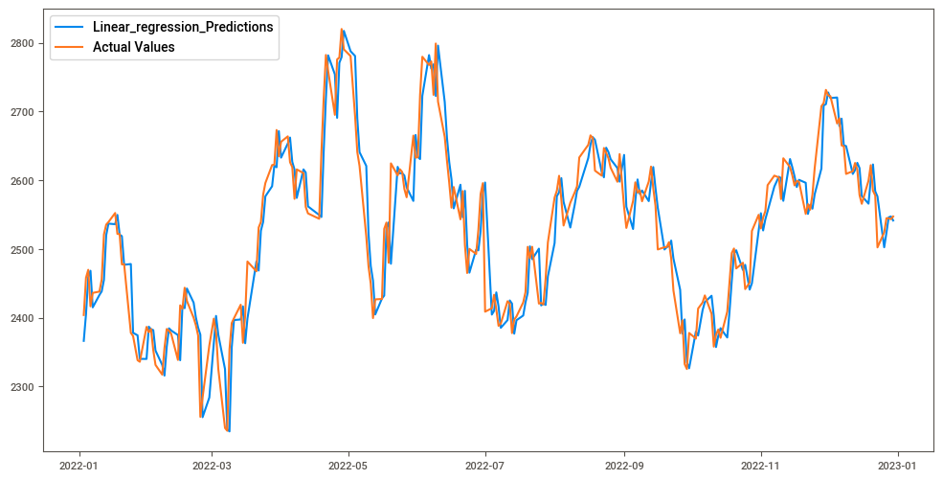
Model Building
1. Linear regression model
This model is giving RMSE value 42.02
Even though this model is giving less rmse value, in the graph we can see that the model is overfitted and can’t be generalized to other tickers.

Slide 17
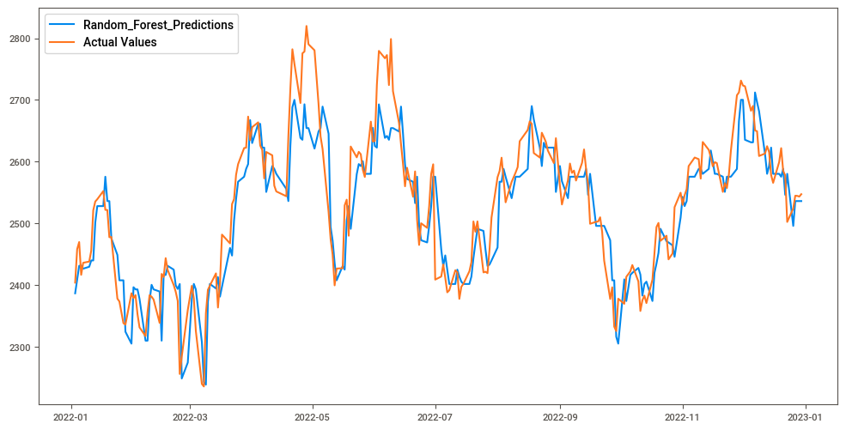
Continue…
2. Gradient boost regressor
The root mean squared error for this model is 52.6.
Validation score is 80%

Slide 18
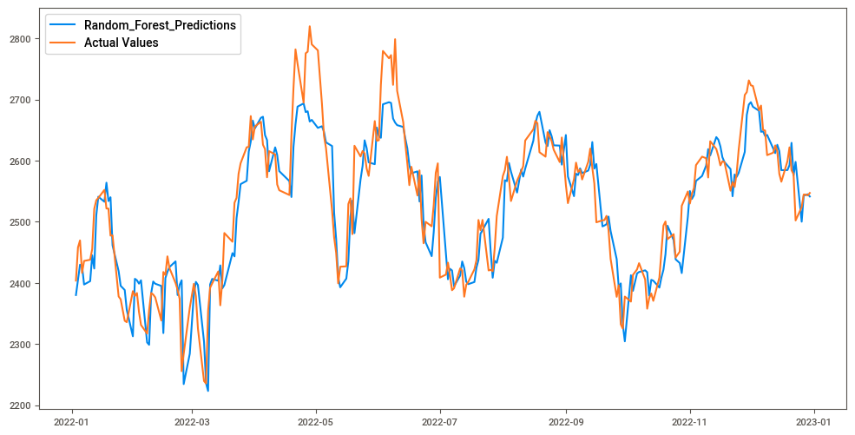
Continue…
3. Random Forest Regression model
Validation score is 83%
RMSE value is 49.2

Slide 19
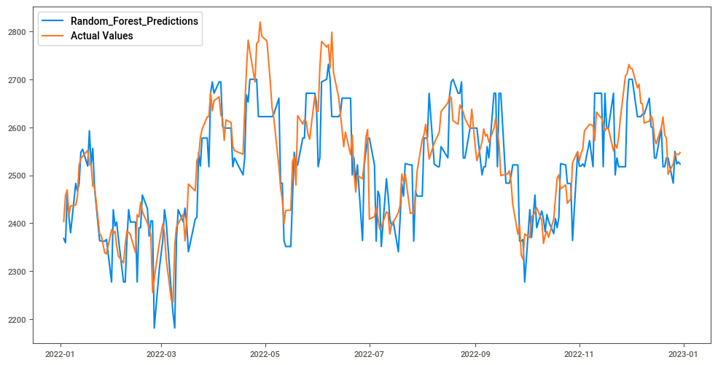
4. Decision tree regressor
RMSE value for this model is 69.
Validation score is 0.66

Slide 20
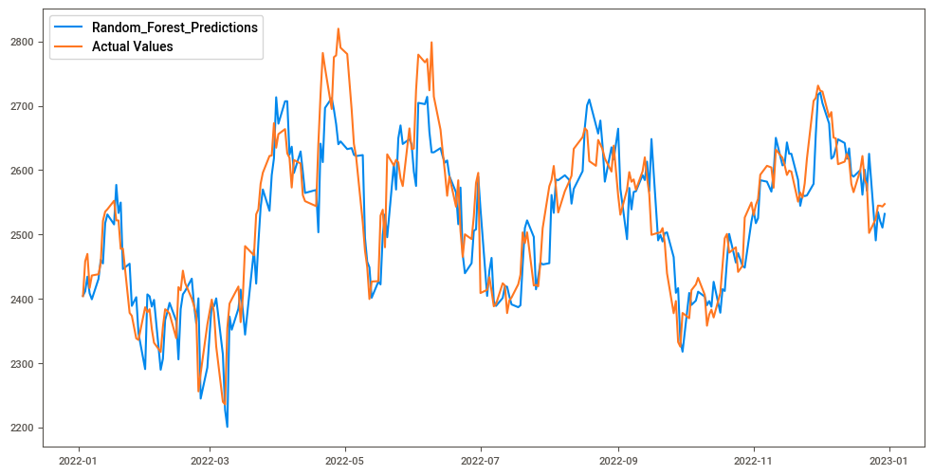
Continue…
5. Extreme Gradient Boosting (XGB)
Here the validation score is 78%
RMSE value is 55.9

Slide 21
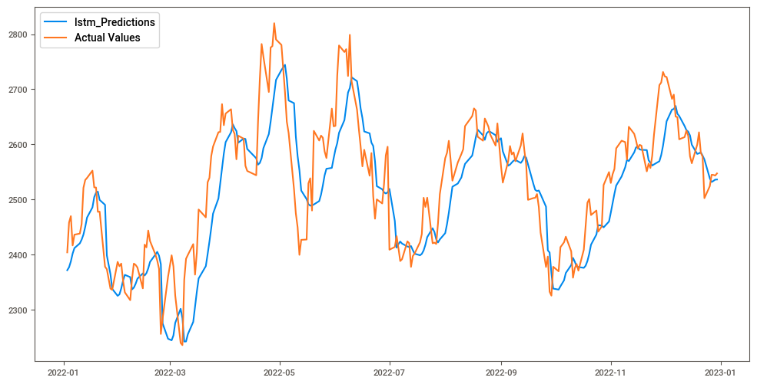
Continue…
6. LSTM
Here the RMSE value is 69
But the model is showing same trend

Slide 22
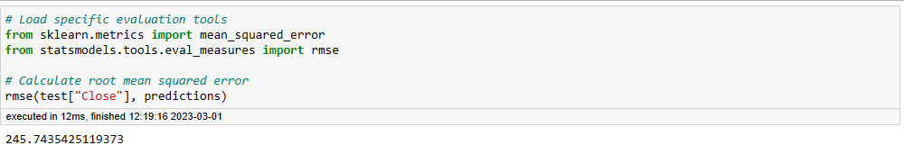
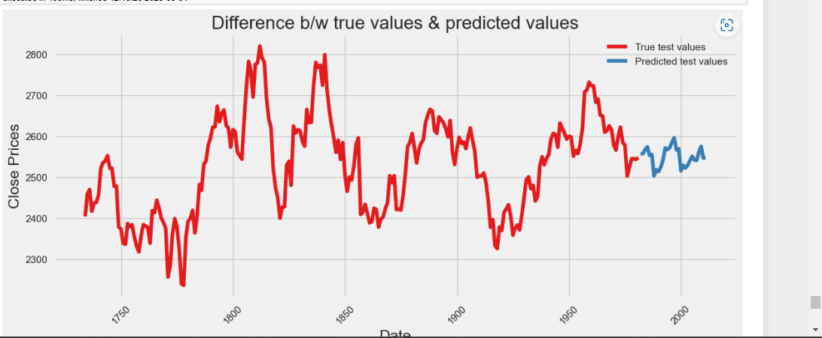
Continue..
7. Sarimax model

Slide 23
Deployment:
Deployment of Reliance_stock has done by Prophet library.
Prophet is a open source library, developed by Facebook to forecast time_series data.

Slide 24
Forecasting of next 30days of Reliance stock :

Slide 25
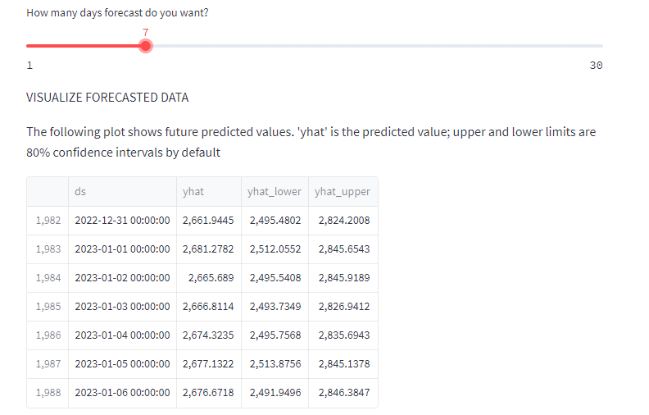
Slider shows the no. of days predicted close price of Reliance stock.
Here, I selected the next 7days forecasting (Reliance).
ds is the Date, yhat is Predicted closing price, yhat_lower is predicted lowest price on that day and yhat_upper is the predicted highest price on that day.

